Slide 1
Spatial Analysis of Train Demand in Greater Melbourne
For GEOM90006 Assignment 4
Lang Chen, Yihan Bao

Slide 2

Research Question and Motivation
Research Question
What is the quantitative impact of weather, demographic and non-residential buildings on train demand in Greater Melbourne
What locations in Greater Melbourne currently do not have a train station but have high predicted demand?
Motivation: Better public transport promotes sustainability and liveability
Both team members frequent train travellers, who are curious about what impacts demand at different stations
Curious about priority of City Tunnel over other potential stations in Melbourne

Slide 3
Data Source
Dataset | Source
Train stop location data and passenger count data | https://discover.data.vic.gov.au/dataset/train-service-passenger-counts
Census Data | https://www.abs.gov.au/census/
Non-residential Facilities Data | - Shopping Centres: https://www.australia-shoppings.com/malls-centres/victoria - Hospitals: https://springernature.figshare.com - Sports Facilities: https://discover.data.vic.gov.au - Schools: https://www.education.vic.gov.au
Rainfall Data | Bureau of Meteorology
SA2 / Greater Capital City Boundary Data | https://www.abs.gov.au/statistics/standards/australian-statistical-geography-standard-asgs-edition-3/jul2021-jun2026/access-and-downloads/digital-boundary-files

Slide 4
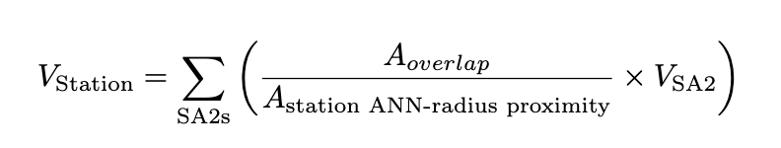
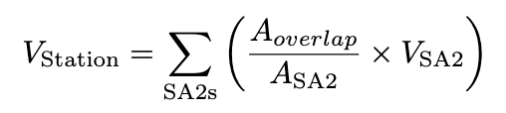
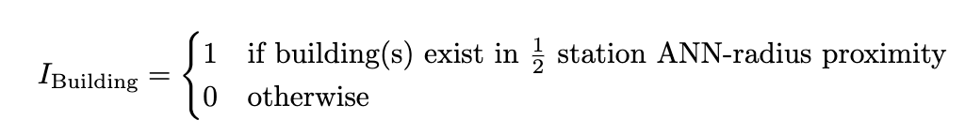
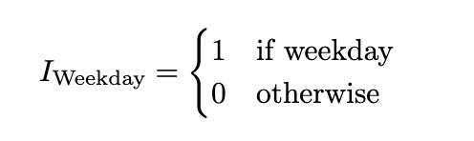
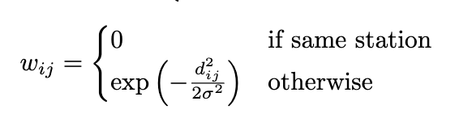
Feature Hypothesis and Representation
Feature | Impact hypothesis | Feature Representation
Mean Rainfall in SA2 | Neg - travellers less inclined to use public transport in rain | (Self explained)
Census Attributes - Median/Mean | Neg [Wealth related] - those in economically better off would prefer private transport
Census Attributes - Total | Pos [Total Population] - more potential customers
Existence of Non-Residential Buildings | Pos or insignificant - these buildings may draw people to travel to region | (*ANN distance = 1.4 km)
Weekday | Pos - more travellers for work related purposes
Weighted Station Demand | Inconclusive - positive as it should correlate with population but nearby stations could take demand away from each other

Slide 5

Model (½): Regression with Weighted Geospatial Features
Through pre-weighting data, transforms spatial data into Tabular Data
Allows use of Machine Learning models such as Linear Regression, Random Forests and Boosting Machines for accurate prediction
Using weighted geospatial features (demand) with regular regression serves similar effect to Geographically Weighted Regression
One model instead of one model per location - better sharing of parameters

Slide 6
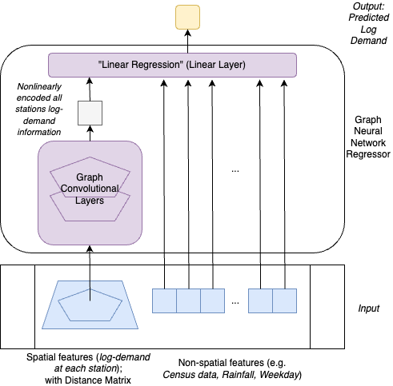
Model (2/2): Attention-Graph Neural Network
Graph Neural Network natural for spatial data
Better encoder to non-linearly represent spatial information
Attention Mechanism in graph automatically mines for relationships between points (stations)
More sophisticated than Linear Regression at factor analysis
Not good for inference on new points (Exogenous prediction)

Slide 7
Evaluation (⅕): Model Performance
Model | Out-of-Sample R2
Linear Regression | 0.3495
Support Vector Machine | 0.5697
Random Forest | 0.7901
Light Gradient Boosting (LGB) | 0.8624
Graph Neural Network (GNN) | 0.9952
Note: LGB is used for forecasting as GNN is only applicable for feature inference

Slide 8
Evaluation (⅖): Feature Analysis
Feature | Linear Interpretation | GNN Interpretation
Weighted sum demand of other stations | N/A | 1% increase in factor=> 0.3% demand inc of this station
Weekday | Weekday has 3.9% less demand than weekends | Weekday has 0.85% more demand than weekends
School | Stations with schools nearby has 70% demand increase | Stations with schools nearby has 0.03% demand increase
Hospital | Stations with hospitals nearby has 41% demand increase | Stations with hospitals nearby has 0.25% demand increase
Sports Facilities | Stations with sports facilities nearby has 6% demand decrease | Stations with sports facilities nearby has 0.2% demand increase
Shopping Centres | Stations with shopping centres nearby has 49% demand increase | Stations with shopping centres nearby has 1.21% demand increase

Slide 9
Evaluation (⅗): Feature Analysis cont.
Feature | Linear Regression | GNN
Mean Rainfall | 1 standard deviation (sd) increase in median annual rainfall => 57% decrease in demand | 1sd increase => 0.23% demand decrease
Total Population | 1sd increase of total nearby population => 48.6% increase in demand | 1sd increase => 2.18% demand increase
Median weekly rent | 1sd increase of median nearby weekly rent => 41% decrease in demand | 1sd increase => 0.27% demand decrease
Median weekly mortgage | 1sd increase of median nearby weekly mortgage => 41% increase in demand | 1sd increase of median nearby weekly mortgage => 0.74% demand decrease
Median weekly income | 1sd increase of median nearby weekly income => 57% increase in demand | 1sd increase of median nearby weekly income => 0.47% demand decrease
Median weekly household income | 1sd increase of median nearby weekly household income => 77% decrease in demand | 1sd increase of median nearby weekly household income => 1.09% demand increase

Slide 10
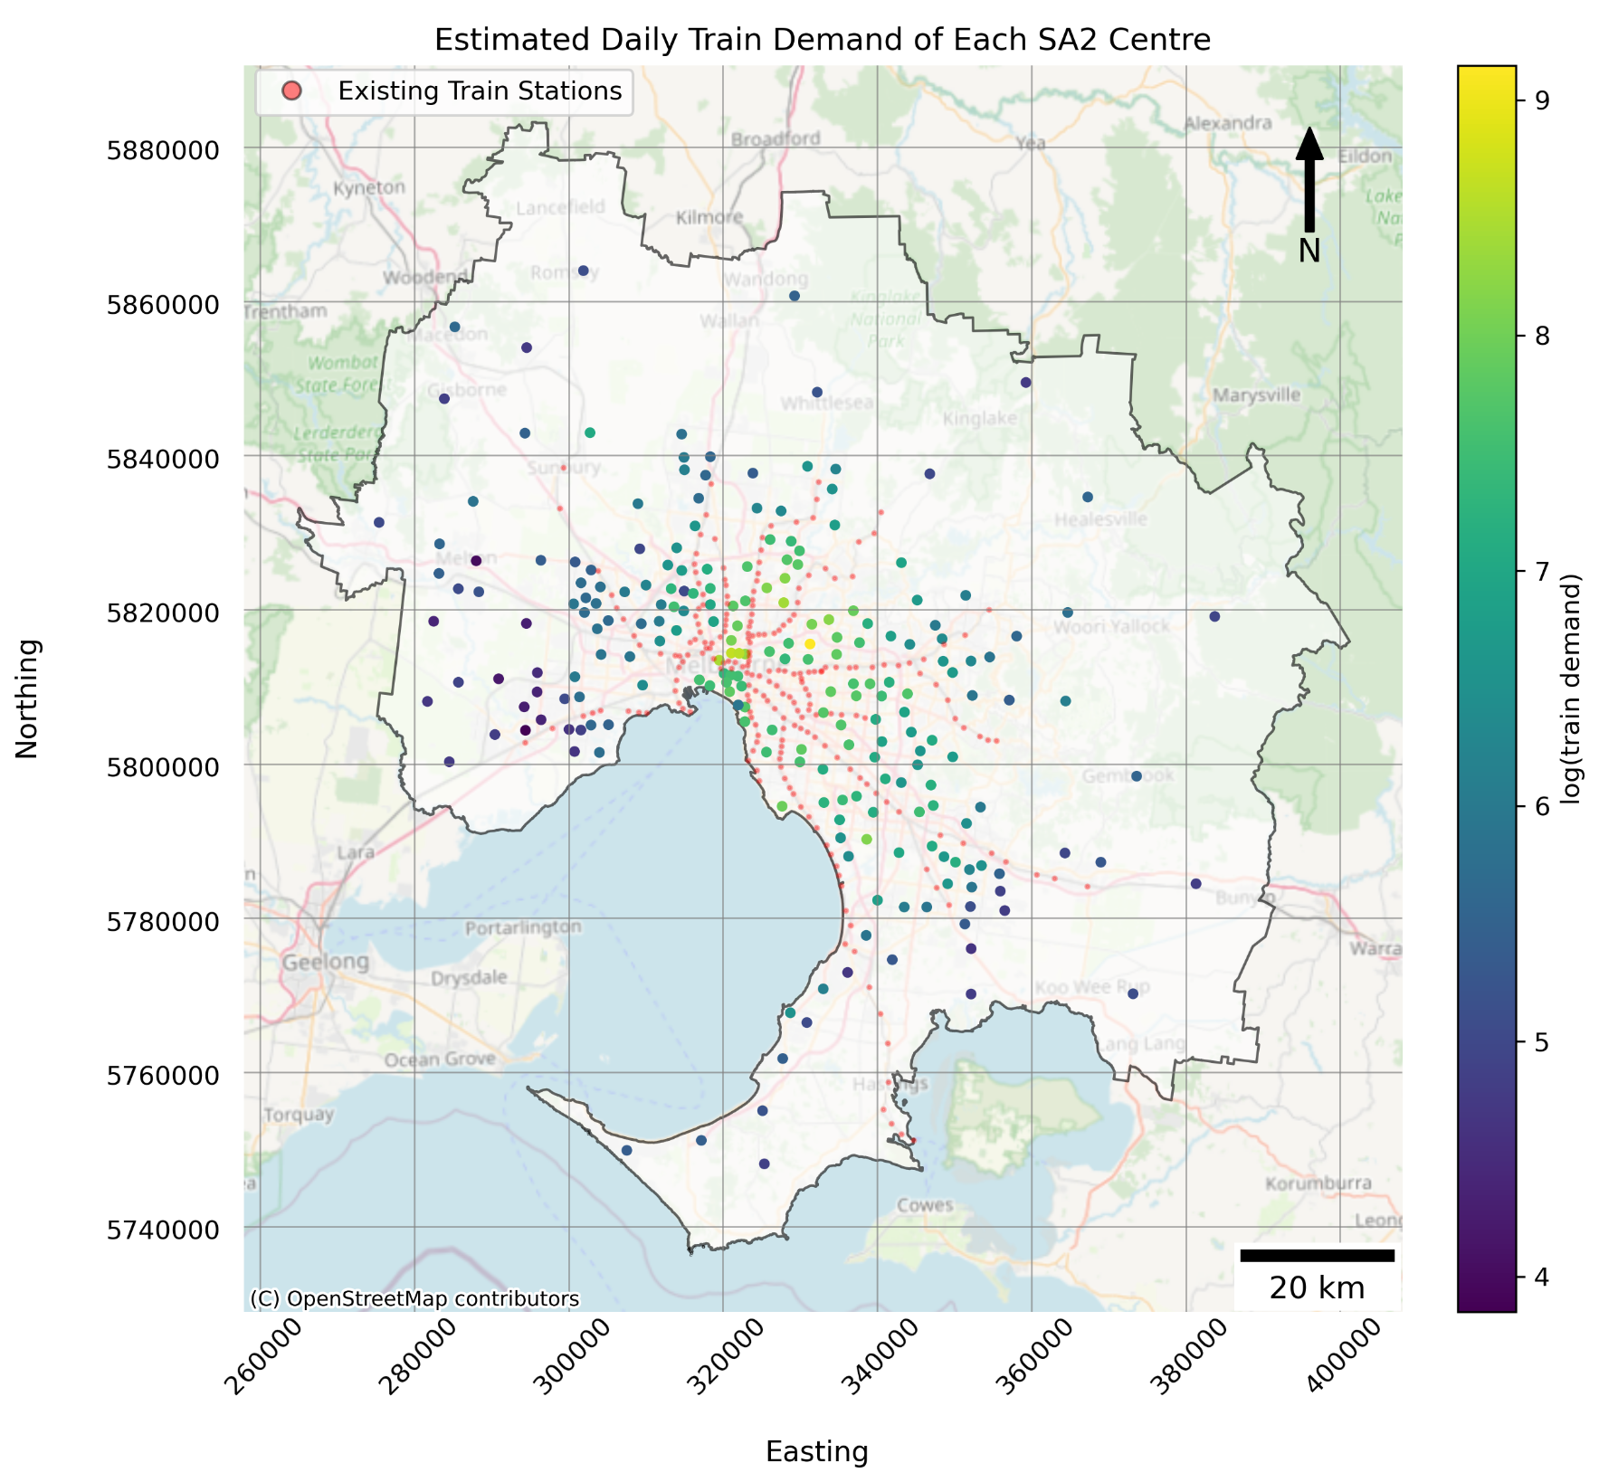
Evaluation (⅘): Point Estimates
Ranking | SA2 | Predicted Daily Demand
1 | Balwyn North | 9331
2 | Carlton | 5717
3 | Fitzroy | 5452
4 | West Melbourne | 4673
5 | Heidelberg West | 4519

Slide 11
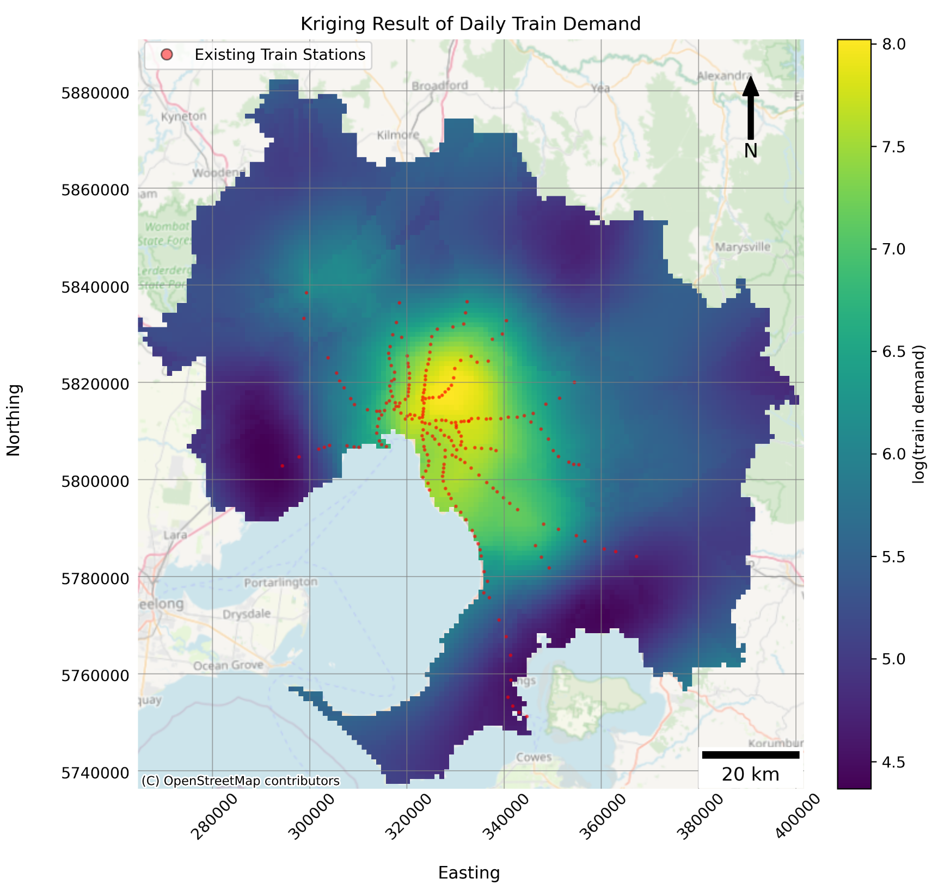
Evaluation (⅘): Kriging
East of Melbourne City needs additional train stations
Some train lines should extend further

Slide 12
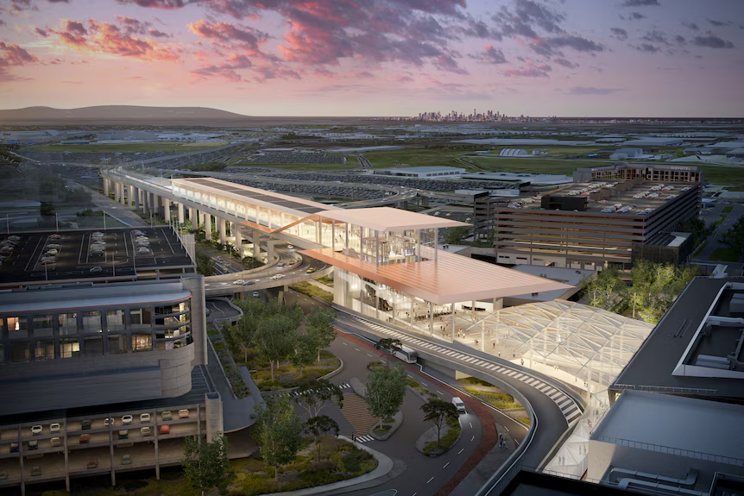
Evaluation (5/5): Future Directions
Research GNN’s encoding ability for prediction
Spatial-temporal forecasting of daily train demand
Empirical factors when recommending new stations

Slide 13
References
Fotheringham, A. S., Oshan, T. M., & Li, Z. (2023). Multiscale geographically weighted regression: Theory and practice (1st ed.). CRC Press.
Selby, B., & Kockelman, K. M. (2013). Spatial prediction of traffic levels in unmeasured locations: applications of universal kriging and geographically weighted regression. Journal of Transport Geography, 29, 24–32.
Song, T., Pu, H., Schonfeld, P., Zhang, H., Li, W., Peng, X., . . . Liu, W. (2021). Gis-based multi-criteria railway design with spatial environmental considerations. Applied Geography, 131, 102449.

